Slide 1
Mobile Application Development (MoAD)
Mahesh S Patil

Slide 2
Books
Text Books (List of books as mentioned in the approved syllabus)
Ed burnette, 1. Hello, Android: Introducing Google's Mobile Development Platform, 3rd Edition, The Pragmatic Bookshelf , 2010
References
Dave Smith and Jeff Friesen, 1. Android Recipes - A Problem-Solution Approach, 2nd Edition, Apress, 2011

Slide 3
CIE+SEE
Assessment | Weightage in Marks
Minor 1 | 15
Minor 2 | 15
Course Project | 20
Total | 50
Evaluated for 20 marks in two Phases with Peer Review

Slide 4
Assessment Dates
Sl.No | Task | Review Date/Week | Marks | Course Incharge Present
1 | Presentation on the problem identified | Week 1 | 10 marks(CC) | MoAD,CC
2 | Intermediate assessment | Week 4 | 05 marks(CC)+8 marks(MoAD) | MoAD,CC
3 | Final Assessment of the activity | Week 12 | 10 marks(CC) + 12 marks(MoAD) | MoAD,CC ,IS

Slide 5
CIE+SEE question pattern
Conceptual Question total marks= 8M.
Questions will be based on topics covered in , notes apart from syllabus.
1a | List the API’s to access the file system in android. | 3 | CO3 | L2 | 1.4.1
1b | Compare between android and Windows8 phone mobile OS | 5 | CO1 | L4 | 1.4.1
1c | Consider the course information of a student. Design a UI to accept CIE, SEE, and credits information for several courses one by one. Draw the snap shots Design the data structure to store the information obtained from UI The UI should display the SGP at the end. Also appropriate message to be flashed when user enters incorrect information for SEE and cie marks(Max 50 Marks) Write android programs performing above points. | 12 | CO2 | L3 | 3.2.2
Single Programming Question with marks 12M.
It can be Exercise or Structured enquiry type questions demanding the usage of android programming concepts along with problem logic
Questions shall be similar to LP but not same as questions from LP

Slide 6
Ground Rules
Attend Classes if you are not attending campus placement activities
Participate in course project and help your self to score better in minor1, minor2 and SEE
Complete course project task within the given schedule. Delayed completion of work shall not be entertained.
Bring Your Own Device(BYOD): laptop, android device to class for Hands-on learning: Compulsory
Fell free to Discuss with me and your friends in class and outside class. But try your self programming before you come up with doubts.
Keep checking the posts in Group over the internet and have update information's

Slide 7
MOBILE APPLICATION DEVELOPMENT CHALLENGES
a) Creating Apps which Get Noticed:
What are the questions you will think about before jumping in to building a mobile app?
Who is my target group?
What is the aim of the app?
Which function does the app have?
Is the app absolutely new or does it improve an existing one or is it an add-on etc.? (Analyze the innovation level, do some research!)
Is there a market for the app? (Do a competitor and/or benchmark analysis or user survey!)
What will be the price of the app? (Analyze the profitability!)
Where will the app be sold? (Selling via the most popular app stores or via extra channels and other/own websites?)
What is it that I am offering and no one has offered before?

Slide 8
MOBILE APPLICATION DEVELOPMENT CHALLENGES
b) Building App with good User eXperience Design:
Dealing with the Screen Real Estate:
Making the App Interactive:
Keeping it Simple and Clear:
i - Phones, tabs
Pixels- resolution
OS versions and Hardwares
- Responsive design
ii - Make use sensors
iii - Recognizable design, colors and logos etched in their memories, or typical fonts.
- Pay attention to the smallest issues

Slide 9
MOBILE APPLICATION DEVELOPMENT CHALLENGES
c) It’s Performance VS Battery Life:
limited battery life
Bug-free app
Performance on latest device VS old devices
Include development team while prototyping
Perform beta testing

Slide 10
MOBILE APPLICATION DEVELOPMENT CHALLENGES
b) Security
Authentication
Server-side validation
Encrypting data
- secure authentication routine : build from - scratch?
- LDAP directory
ii - Validations on the server is easy
- It also reduces app complexity
- It improves app performance
iii - keep all sensitive data encrypted
- It protects the enterprise apps in cases where devices are lost or compromised.

Slide 11
Reflect
Which one of the challenge is most important to be addressed ?
You are about to build app- “Learning through interactive animation” . What will be the answers to the questions that you ask to yourself before you build such app.

Slide 12
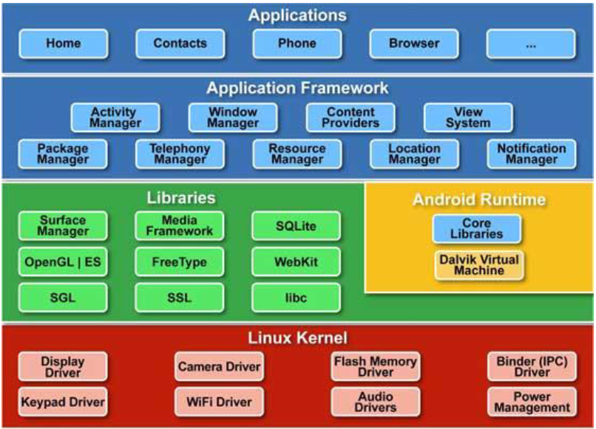
2.1 The Big Picture

Slide 13
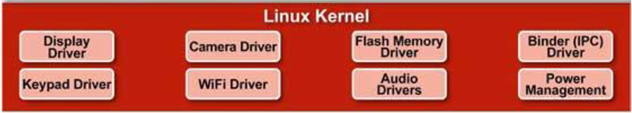
Linux Kernel
This provides basic system functionality
process management
memory management
device management ex:camera, keypad, display
kernel handles all networking and device drivers

Slide 14
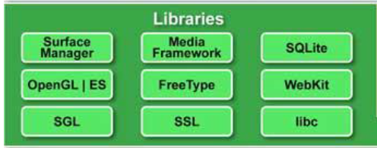
Native Libraries
shared libraries are all written in C or C++, compiled for the particular hardware architecture used by the phone
Surface Manager:
drawing is on off-screen bitmaps that are then combined with other bitmaps
system create all sorts of interesting effects. Ex: see-through windows , fancy transitions
2D and 3D graphics:
Two- and three-dimensional elements can be combined in a single user interface with Android.
Uses 3D hardware or fast software renderer
Media codecs:
play video and record and play back audio
AAC
AVC (H.264)
H.263
MP3
MPEG-4… etc

Slide 15
Native Libraries
SQL database:
lightweight SQLite database engine
use this for persistent storage in your application.
Browser engine:
WebKit library
shared libraries . They exist only to be called by higher-level programs.
you can write and deploy your own native libraries using the Native Development Toolkit (NDK).
Compiled to specific hardware

Slide 16
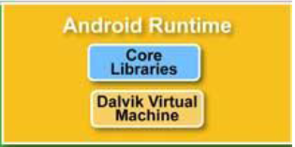
Android Runtime
includes the Dalvik virtual machine and the core Java libraries.
Dalvik VM
optimized Bytecode in terms of low memory and battery.
The Dalvik VM enables every Android application to run in its own process, with its own instance of the Dalvik virtual machine.
The Dalvik VM runs .dex files, which are converted at compile time from standard .class and .jar files.
Java libraries that come with Android are different from both the Java Standard Edition (Java SE) libraries and the Java Mobile Edition (Java ME) libraries.

Slide 17
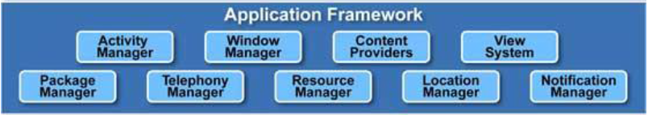
Application Framework
This layer provides the high-level building blocks you will use to create your applications.
Activity Manager:
This controls the life cycle of applications
Content providers:
These objects encapsulate data that needs to be shared between applications, such as contacts.
Resource manager:
Resources are anything that goes with your program that is not code.
Notification manager:
Events such as arriving messages, appointments, can be presented in an unobtrusive fashion to the user.
Location manager:
An Android phone always knows where it is.

Slide 18
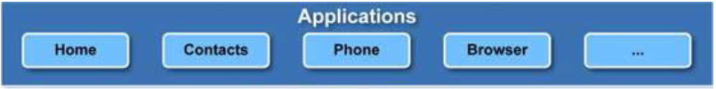
Applications and Widgets
End users will see these programs
Applications are programs that can take over the whole screen and interact with the user.
Widgets operate only in a small rectangle of the Home screen application.

Slide 19
Reflect
Y DVM?
What is NDK? What are the disadvantage of providing NDK

Slide 20
2.2 It’s Alive!
there is one foreground application, which typically takes over the whole display except for the status line.
first application seen is the Home application
All the opened programs and screens are recorded on the application stack by the system’s Activity Manager

Slide 21
Process != Application
An application is one or more activities plus a Linux process to contain them.
an application can be “alive” even if its process has been killed.
activity life cycle is not tied to the process life cycle.
Processes are just disposable containers for activities.

Slide 22
Activity life cycle
An activity represents a single screen with a user interface.
An activity is implemented as a subclass of Activity
Its Methods
onCreate()
onStart()
onRestoreInstanceState()
onResume()
onSaveInstanceState()
onPause()
onStop()
onDestroy()
public class MainActivity extends Activity
{
}

Slide 23
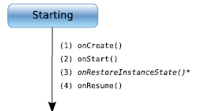
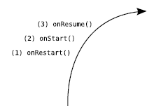

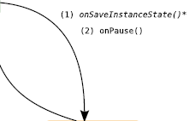
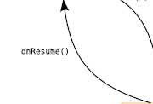



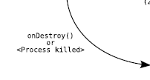
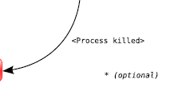

Life Cycles of the Rich and Famous

Slide 24
Activity life cycle
Hands-on : Create an activity and over-raid all method with a Log cat message.

Slide 25

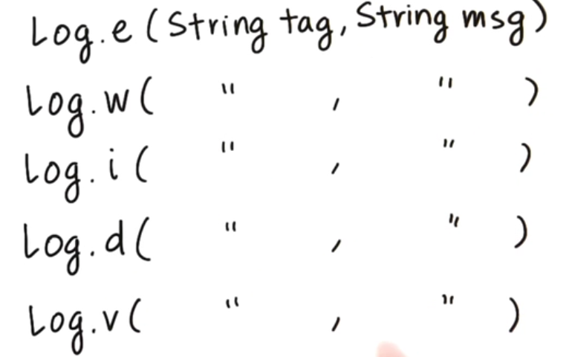

Log cat

Slide 26
Project Directory

Slide 27
R
Resource can be text, bitmap or any non code information
Android resource compiler (aapt) packs them into apk and generates a class R
Each resource is identified by an assigned id
Never modify class R

Slide 28
Intents
Video
Intent are also used perform actions like
View a link browser
Pick a photo
Pick a phone
Send an email
An activity can also receive an intent and get triggered

Slide 29
Intents
Hands-on : create another activity. Then launch the it form main activity using Intent

Slide 30
Services
A service is a component that runs in the background to perform long-running operations.
For example, a service might play music in the background
A service is implemented as a subclass of Service class as follows:
public class MyService extends Service
{
}

Slide 31
Content Providers
We take-up this later, after you are introduced to programming with sql

Slide 32
2.5 Safe and Secure
every application runs in its own Linux process
The hardware forbids one process from accessing another process’s memory.
every application is assigned a specific user ID.
You must specifically ask for permission to use them in a file named Android- Manifest.xml.
Ex:
<manifest xmlns:android="http://schemas.android.com/apk/res/android"
package="com.google.android.app.myapp" >
<uses-permission android:name="android.permission.RECEIVE_SMS" />
</manifest>

Slide 33
Following topics will not be included in minors, SEE
Protocols
The operating systems for mobile applications.
Introduction to development environment.
Issues of power management will included as part of 3rd unit

Slide 34
END OF CHAPTER 1

